Slide 1

Mental Health Awareness
The loss of product due to the impact of war refers to the destruction, damage, or disruption of goods, services, and production processes that occur during armed conflict. This type of loss can significantly affect economies, supply chains, and the livelihoods of populations. Here’s a breakdown of the major dimensions:
Among Teenagers

Slide 2
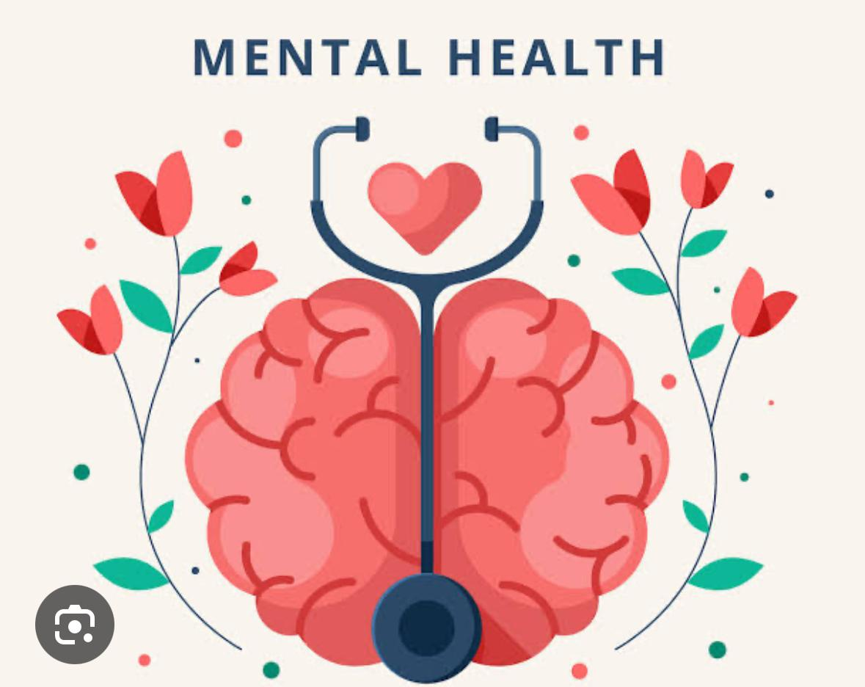
Emotional, psychological, and social well-being
Affects how we think, feel, and act
Important at every stage of life

Slide 3

Why Focus on Teenagers
Major life transitions
Academic pressure
Identity and self-esteem issues
Peer influence and social media impact

Slide 4

Common Mental Health Issues in Teens
Anxiety disorders
Depression
Eating disorders
Self-harm and suicidal thoughts

Slide 5

Warning Signs
Withdrawal from friends and activities
Mood swings
Poor academic performance
Changes in sleep/eating habits

Slide 6
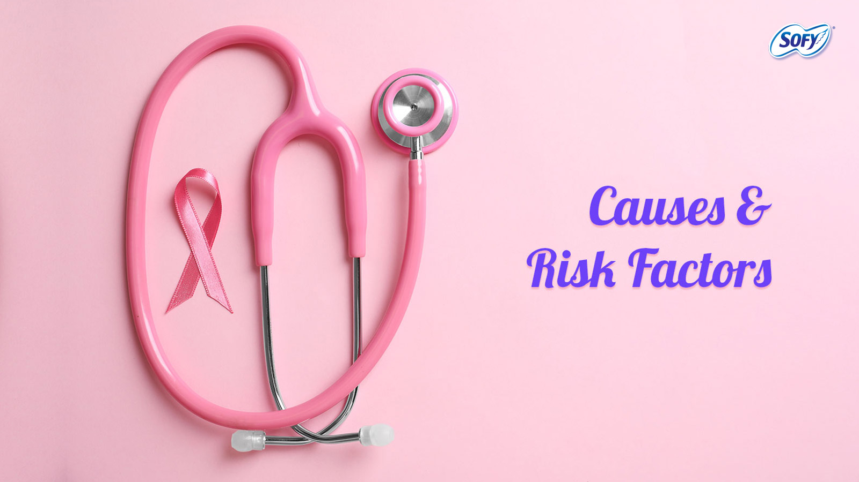
Causes & Risk Factors
Genetics and family history
Trauma or abuse
Bullying or cyberbullying
Academic or peer pressure

Slide 7
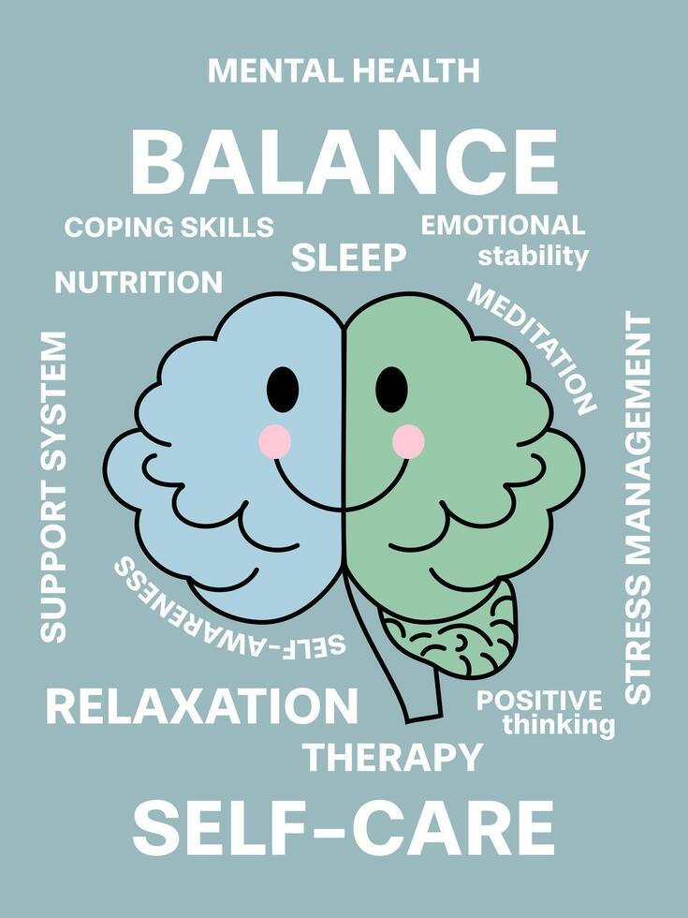
How to Promote Mental Wellness
open conversations
Physical activity and sleep
Healthy social media use
Coping strategies (journaling, hobbies, etc.)

Slide 8

When to Seek Help
Persistent sadness or anxiety
Self-harm or suicidal thoughts
Contact: School counselor, therapist, or helpline

Slide 9
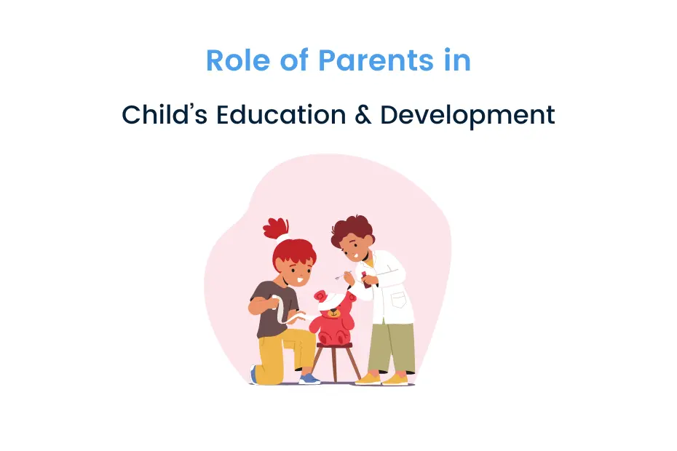
create a safe, supportive environment
Encourage expression of emotions
Be observant and proactive

Slide 10

Final Thoughts
Mental health is just as important as physical health
Early help can save lives
Let’s reduce stigma and speak up!

Slide 11


